Slide 1
Happiness Prediction of a country
Jinghua Yao, Junlin Chen, Danny Lou,David Wang, Matt YongWook Lee

Slide 2
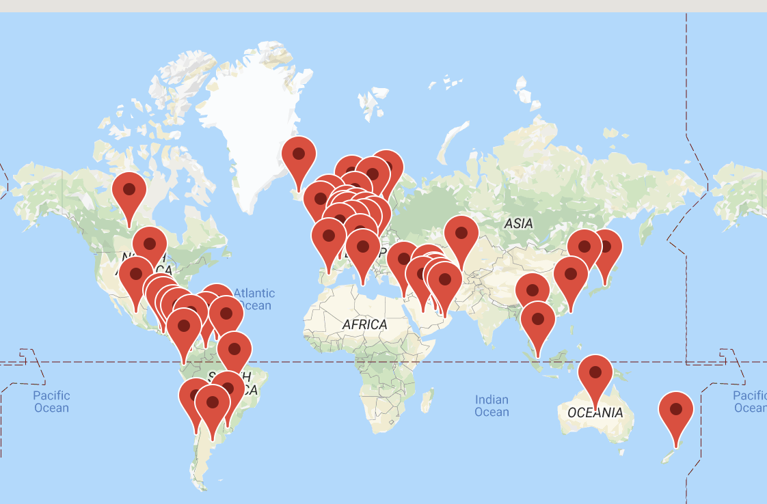
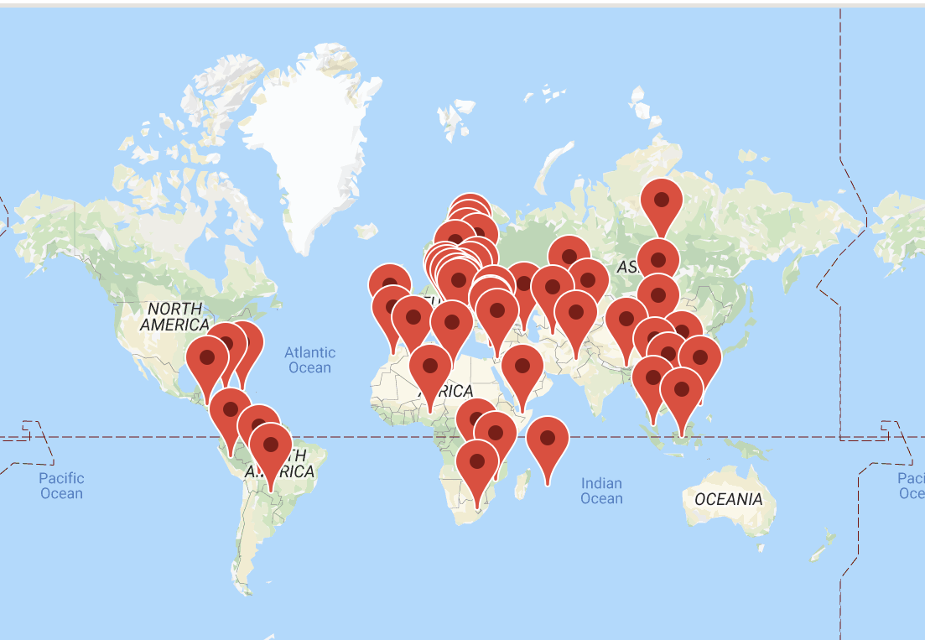
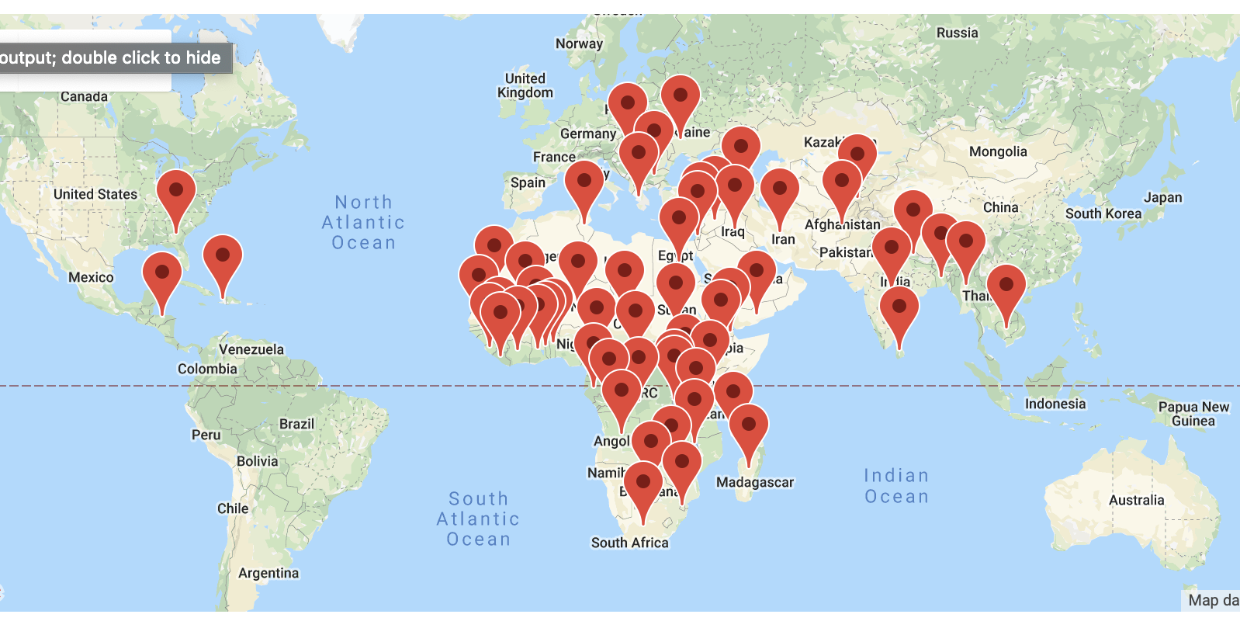
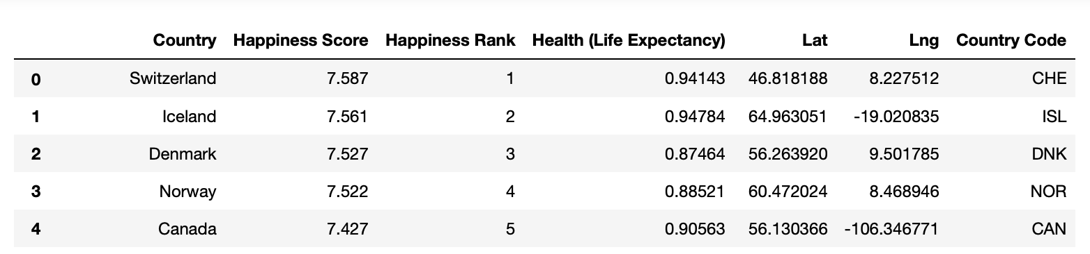
Overview of 2015 World Happiness ranking
Data source:
Kaggle.com :https://www.kaggle.com/unsdsn/world-happiness#2015.csv
Gmap API request: https://maps.googleapis.com/maps/api/geocode/json?''address={0}&key={1}').format(country, gkey)
Top 50 Happiness Country
51-100 Happiness Country
100-158 Happiness Country

Slide 3
Questions to answer
What factors has best correlation to the Happiness Score
Can we predict Happiness Score by a model

Slide 4
Possible Factors contribute to Happiness
Education (Matt YongWook Lee)
Government total expenditure on Education and School enrollment rate
Population (David Wang)
Total population, male population, female population, rural population and urban population
Economy (Junlin Chen)
GDP, Unemployment Rate, Cost of living, Purchasing Power index and pollution index
Technology (Danny Lou)
Internet users (% of population), Cellular subscriptions, Broadband subscriptions
Health (Jinghua Yao)
Life Expectancy, Current Health Expenditure, Government Health Expenditure, Out of Pocket Expenditure
Suicide Rate

Slide 5
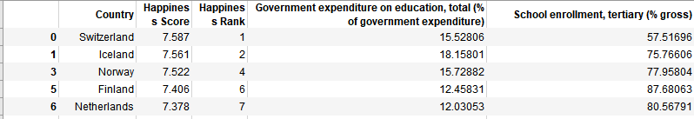
Factors in Education to Happiness score 2015
Data Collection and organization using pandas
Government expenditure on education, total(% of government expenditure) (Worldbank, csv)
School enrollment (% gross) (Worldbank, csv)
Literacy Rate Adult total (%of people ages 15 or older) (Worldbank, csv)

Slide 6
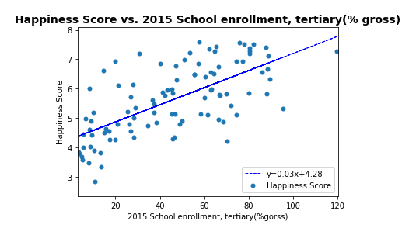
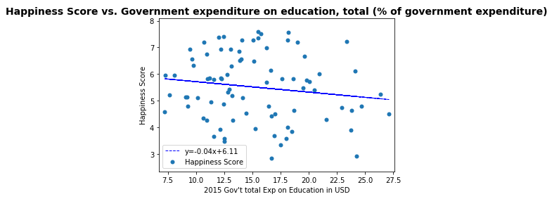
Education factors vs. Happiness Score 2015
Methods:
Scatter plotting by Matplotlib,
Linear Regression

Slide 7
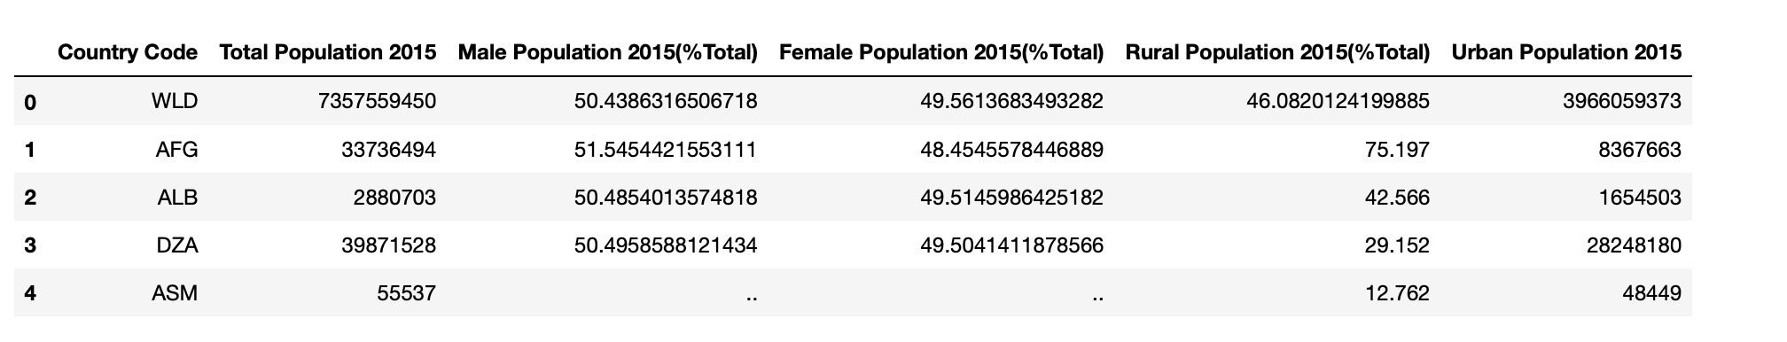
Factors in Populations to Happiness score 2015
Data Collection and Source:
World Populations ( World Bank, csv )
Population Male %Total ( World Bank, csv )
Population Female %Total ( World Bank, csv )
Rural Population % Total ( World Bank, csv )
Urban Population ( World Bank, csv )

Slide 8
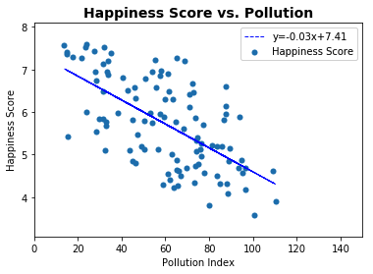
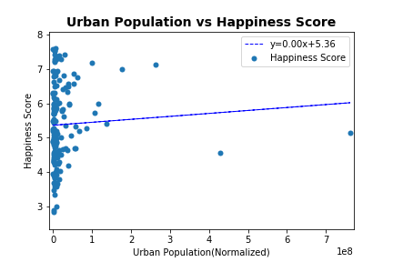
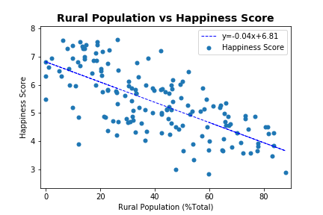
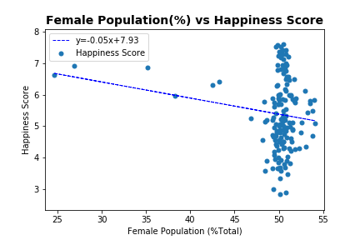
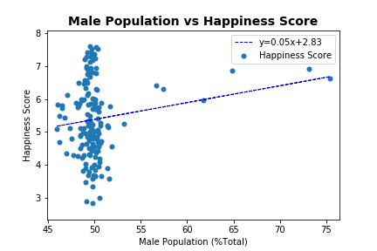
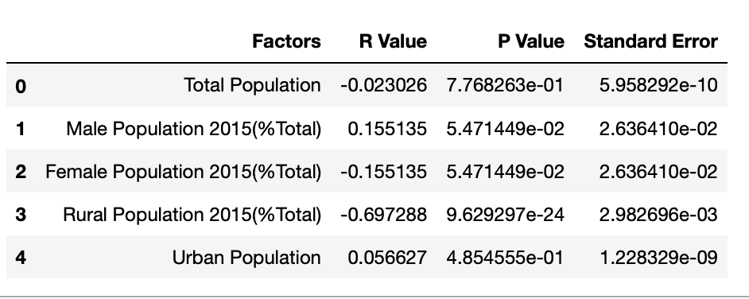
Factors in Populations to Happiness score 2015

Slide 9
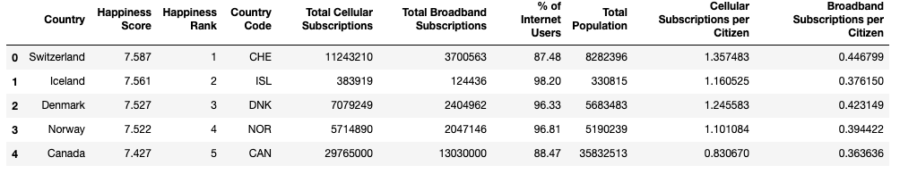
Technology factors vs. Happiness score 2015
Data Collection and organization using pandas
Internet Users (% of population) (Worldbank, csv)
Total Cellular Subscriptions (Worldbank, csv)
Total Broadband Subscriptions (Worldbank, csv)
Population (Worldbank, csv)
Divide totals data by population to calculate subscriptions per citizen

Slide 10
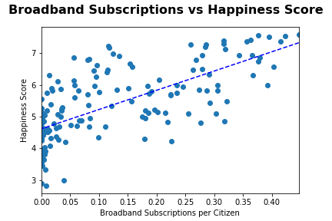
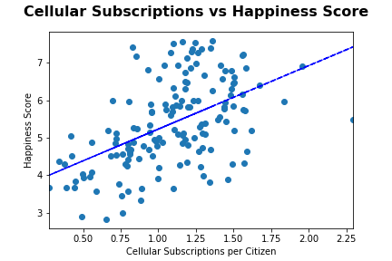
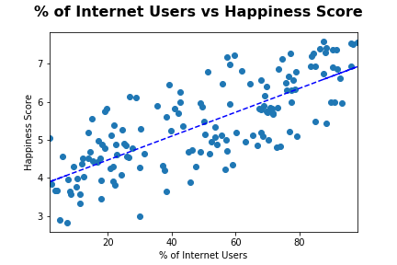
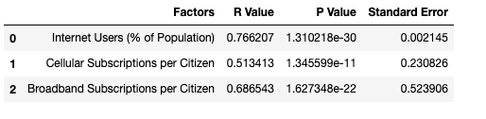
Technology factors vs. Happiness Score 2015
Methods:
Scatter plotting by Matplotlib,
Linear Regression

Slide 11
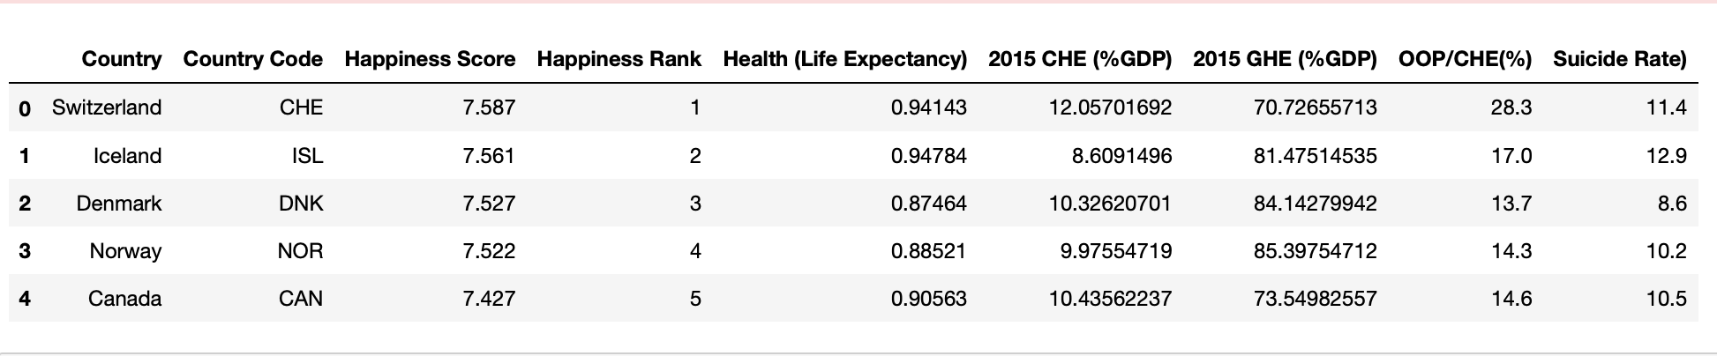
Factors in Healthcare to Happiness score 2015
Data Collection and organization using pandas and API request
Life Expectancy (Kaggle, csv)
Current Health Expenditure( %GDP)(Worldbank, csv)
Government Health Expenditure(%GDP)(Worldbank, csv)
Out of Pocket Expenditure(%GDP) (WHO, API request)
Suicide Rate (WHO,API request)

Slide 12
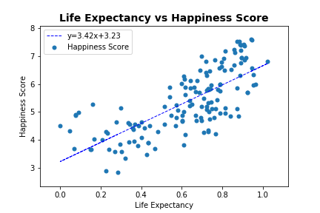
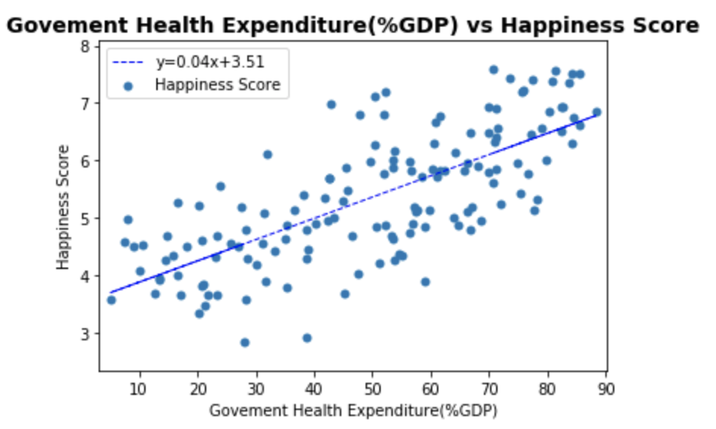
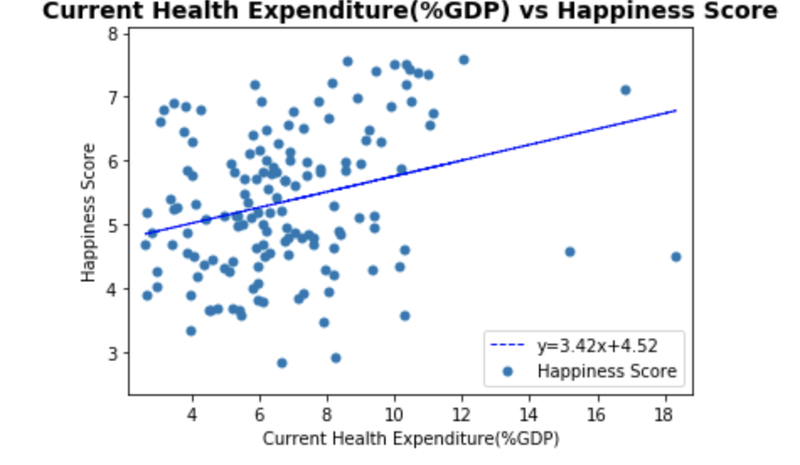
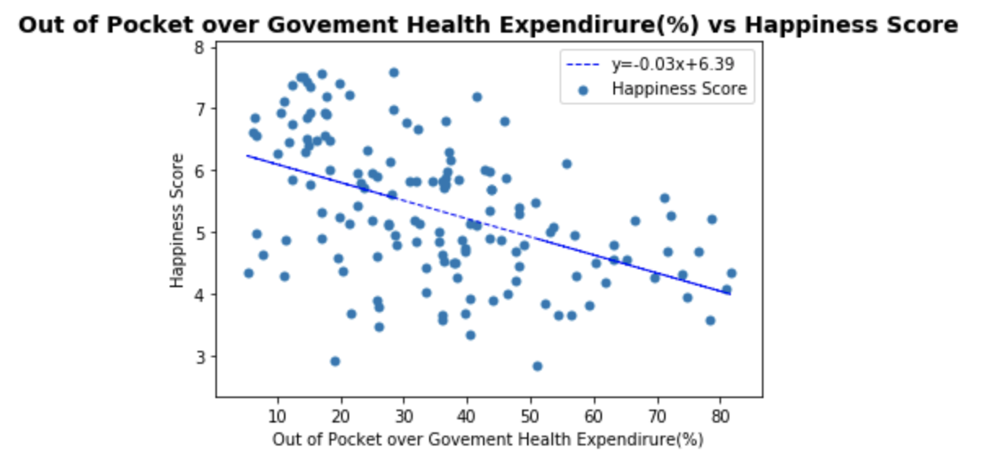
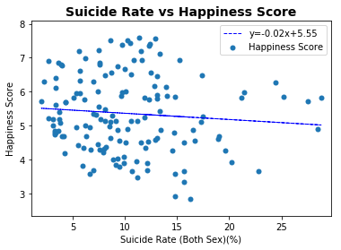
Health Factors to Happiness Score 2015
Methods:
Scatter plotting by Matplotlib,
Linear Regression

Slide 13
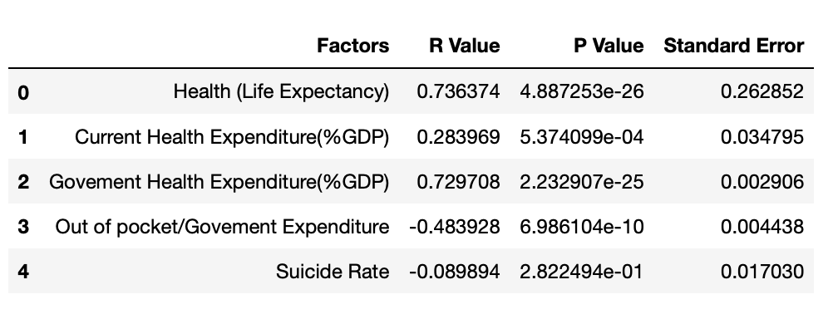
Statistic of Health Factors
Best Factors in Health: Govement Health Expenditure(%GDP)

Slide 14
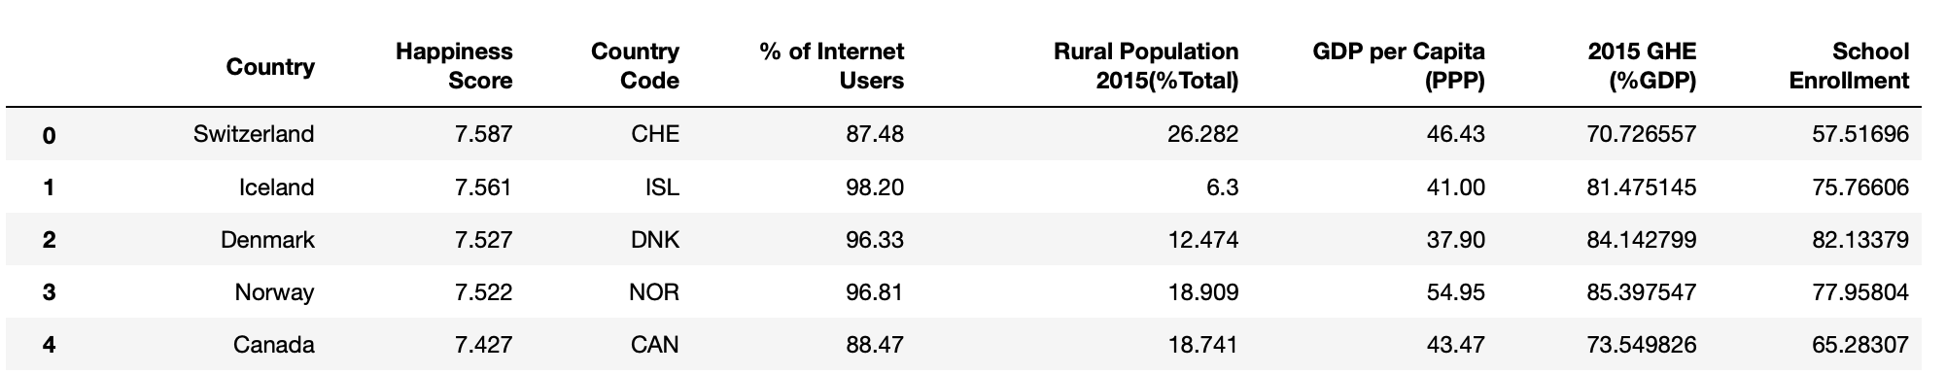
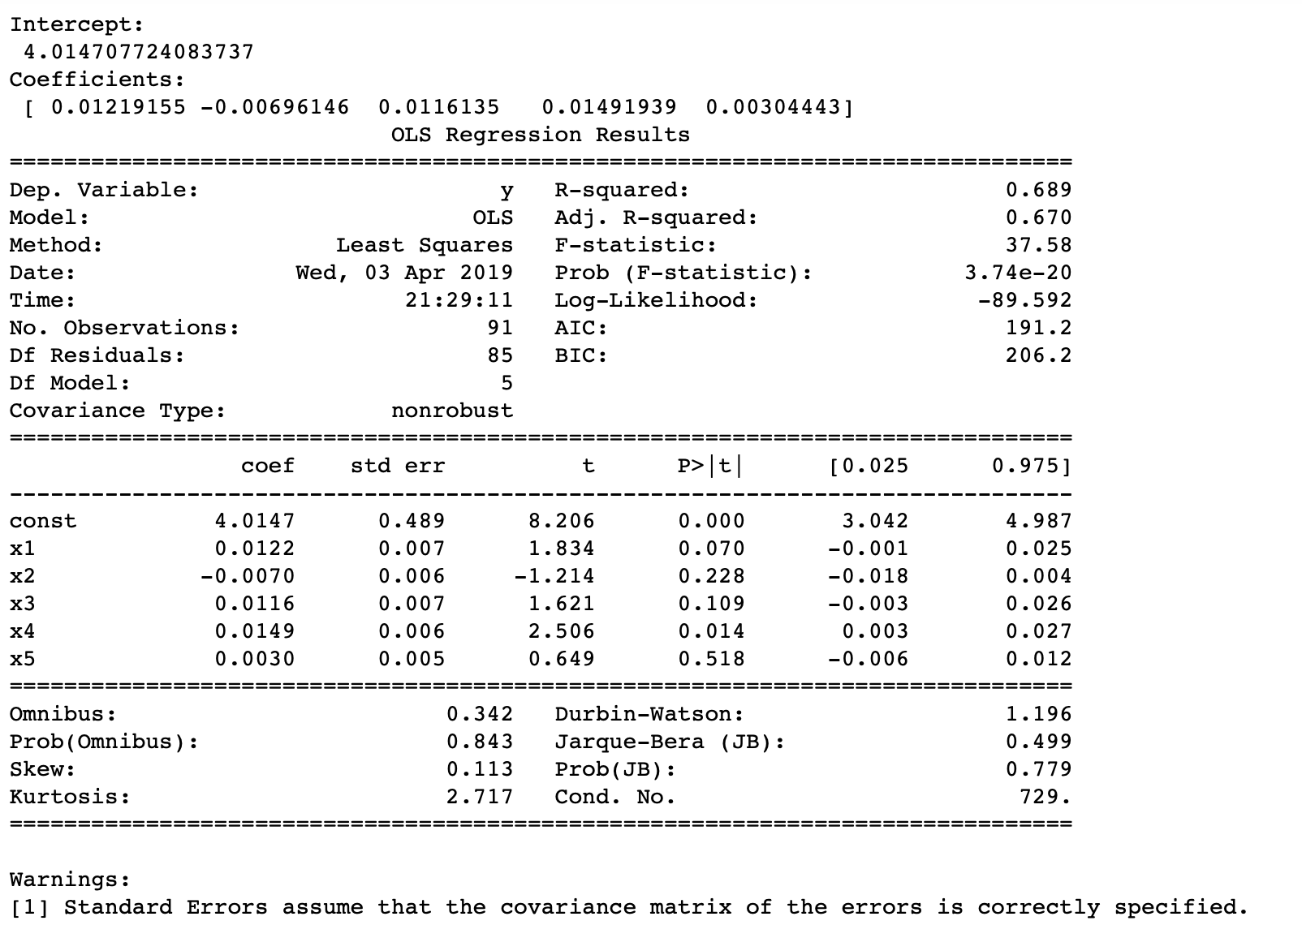
Happiness Value Model
Methods: statsmodels.regression.linear_model.OLS
Modle: Y=0.0122X1-0.007X2+0.0116X3+0.0149X4+0.003X5+4.0147
Y= Happiness Score
X1= Internet Users (% of population)
X2=Rural Population (% Total)
X3=Average GDP per capita (PPP)
X4=Government Health Expenditure(GHE) (%GDP)
X5=School enrollment (% gross)

Slide 15
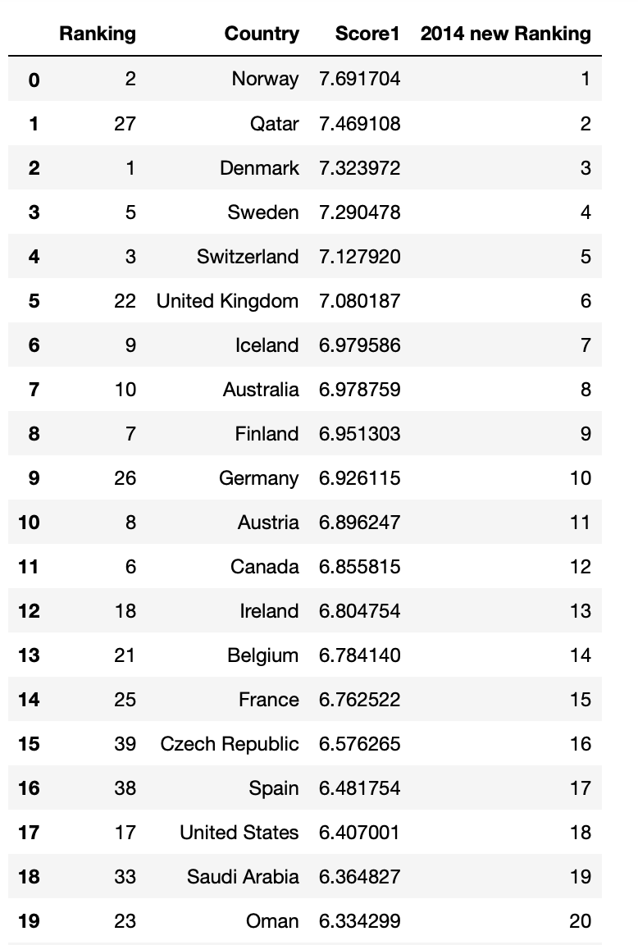
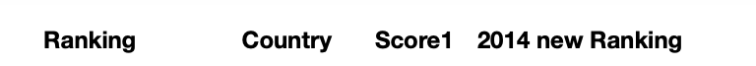
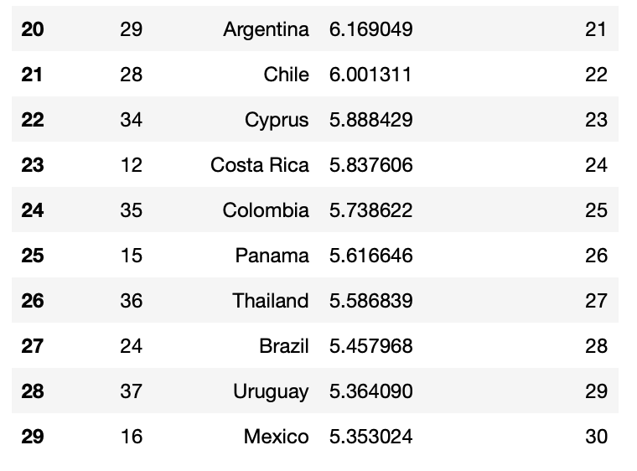
Model Testing in 2014 world Happiness Score
Methods: sklearn, regr.predict
Test Sample: Top30 of 2014 Happiness countries data

Slide 16

Conclusion
1. We are able to build model to predict Happiness score by multiple factors
2. Accuracy of the model may depend on the comprehensive level of factors
3. Data size is also important to accuracy of the model
I Love Data

